Slide 1

VogueNaija Retail Case Study(Hybrid Fashion Retailer)
Notes:
AI-generated content may be incorrect. ---

Slide 2

Overview of VogueNaija
Hybrid Fashion Retail was launched in Jan 2023: Pop-up + Mobile-First E-Commerce
Coverage Reach
The platform serves users across Nigeria’s North, South, East, and West geopolitical zones.
Multi-Device Accessibility
Users can shop In-Store, Online, on mobile phones, and on desktop computers
Segment
VogueNaija has the VIP and Regular segments with 200+ customers.
Notes:
--- This slide references information from the following file: https://ulster-my.sharepoint.com/personal/adebayo-ad_ulster_ac_uk/Documents/Microsoft%20Copilot%20Chat%20Files/NaijaStream%20PDF%20EXCEL.pdf NaijaStream is Nigeria’s indigenous video-streaming platform that offers a variety of subscription plans tailored to meet the entertainment needs of its diverse user base. The service provides three subscription tiers—Basic, Standard, and Premium—available on both monthly and annual billing cycles. Headquartered in Lagos, NaijaStream reaches audiences across Nigeria’s geopolitical zones: North, South, East, and West. Users access content through multiple devices including Mobile phones, Desktop computers, and Smart TVs. This broad accessibility ensures that NaijaStream remains a competitive player in the digital media landscape. The company’s mission is to deliver high-quality streaming content while optimizing user engagement and retention through data-driven strategies.

Slide 3


Key Characteristics of NaijaStream
Total Sales: ₦209,397,568
Total Units Sold: 18,174
Customer Count: 200
Average Order Value (AOV): ₦34,888
YoY Growth: -1.81%
Notes:
--- This slide references information from the following file: https://ulster-my.sharepoint.com/personal/adebayo-ad_ulster_ac_uk/_layouts/15/Doc.aspx?sourcedoc=%7BE3F7B0B7-554E-4598-8291-D631F943A80D%7D&file=NAIJA%20STREAM%20EXCEL%20FILE%20(DASHBOARD,%20KPI,%20CLEAN%20DATA%20AND%20RAW%20DATA).xlsx&action=default&mobileredirect=true NaijaStream’s business model is defined by its subscription-based structure, offering three tiers—Basic, Standard, and Premium. Each tier caters to different user needs and price sensitivities. The platform operates across four major regions in Nigeria, ensuring nationwide coverage. Device usage statistics reveal that Mobile accounts for 40% of user engagement, Desktop for 50%, and Smart TV for 10%. Financially, the company has generated a total revenue of ₦12,099,800 from 2,000 orders. Monthly Recurring Revenue (MRR) stands at ₦498,000, while Annual Recurring Revenue (ARR) is ₦5,976,000. The Average Revenue Per User (ARPU) is ₦498,000, indicating strong monetization potential. These metrics highlight NaijaStream’s robust operational footprint and its capacity for scalable growth.

Slide 4

Major Problem Facing VogueNaija Retail
Lack of centralized, real-time analytics across channels/regions
Fragmented decision-making; delayed KPIs
Limited visibility into VIP behaviour and channel ROI
Notes:
--- This slide references information from the following file: https://ulster-my.sharepoint.com/personal/adebayo-ad_ulster_ac_uk/Documents/Microsoft%20Copilot%20Chat%20Files/NaijaStream%20PDF%20EXCEL.pdf NaijaStream faces a significant challenge in managing user churn, which currently stands at a high rate of 49.35%. This issue is compounded by the lack of clear visibility into regional subscription dynamics, churn patterns, and device usage. These gaps in data insight lead to unpredictable revenue fluctuations and hinder strategic investments in content and retention initiatives. Without targeted interventions, NaijaStream risks losing valuable subscribers and revenue. Addressing this problem requires a comprehensive understanding of user behavior across different regions and devices, as well as the implementation of proactive retention strategies.

Slide 5

Objectives of the Analysis
Unify & clean data; build star schema
Define & track KPIs (Sales, Units, AOV, Customers, YoY)
Automate dashboards for executives & regional managers (Executive Overview, Customer & Product Insight and Channel & Regional Performance).
Notes:
--- This slide references information from the following file: https://ulster-my.sharepoint.com/personal/adebayo-ad_ulster_ac_uk/Documents/Microsoft%20Copilot%20Chat%20Files/NaijaStream%20PDF%20EXCEL.pdf The primary objectives of the analysis are to empower NaijaStream’s leadership with actionable insights into revenue drivers segmented by region, subscription tier, and device type. By identifying at-risk user segments, the company aims to deploy targeted retention tactics that minimize revenue loss due to cancellations. Additionally, the analysis seeks to uncover month-over-month subscriber trends and ARPU disparities, enabling the optimization of pricing strategies and promotional timing. These objectives are aligned with the broader goal of enhancing user engagement and maximizing return on investment through data-driven decision-making.

Slide 6
Specific Goals of the Analysis & Visualization
Executive Overview: KPIs, trend, channel/region distribution
Customer & Product: segment mix, categories, top SKUs, discounts
Channel & Regional: channel trend, state matrix, top/bottom states, map
Notes:
--- This slide references information from the following file: https://ulster-my.sharepoint.com/personal/adebayo-ad_ulster_ac_uk/Documents/Microsoft%20Copilot%20Chat%20Files/NaijaStream%20PDF%20EXCEL.pdf The visualization component of the analysis is designed to address several key business questions. These include quantifying total revenue, total orders, MRR, ARR, ARPU, and churn rate. The dashboard also visualizes device usage distribution and regional revenue breakdowns. It provides insights into average revenue per subscription tier and compares churn versus retention across tiers. Additionally, the dashboard identifies top revenue-generating states and tracks growth trends over time. These visualizations serve as a strategic tool for monitoring performance and guiding business decisions.

Slide 7
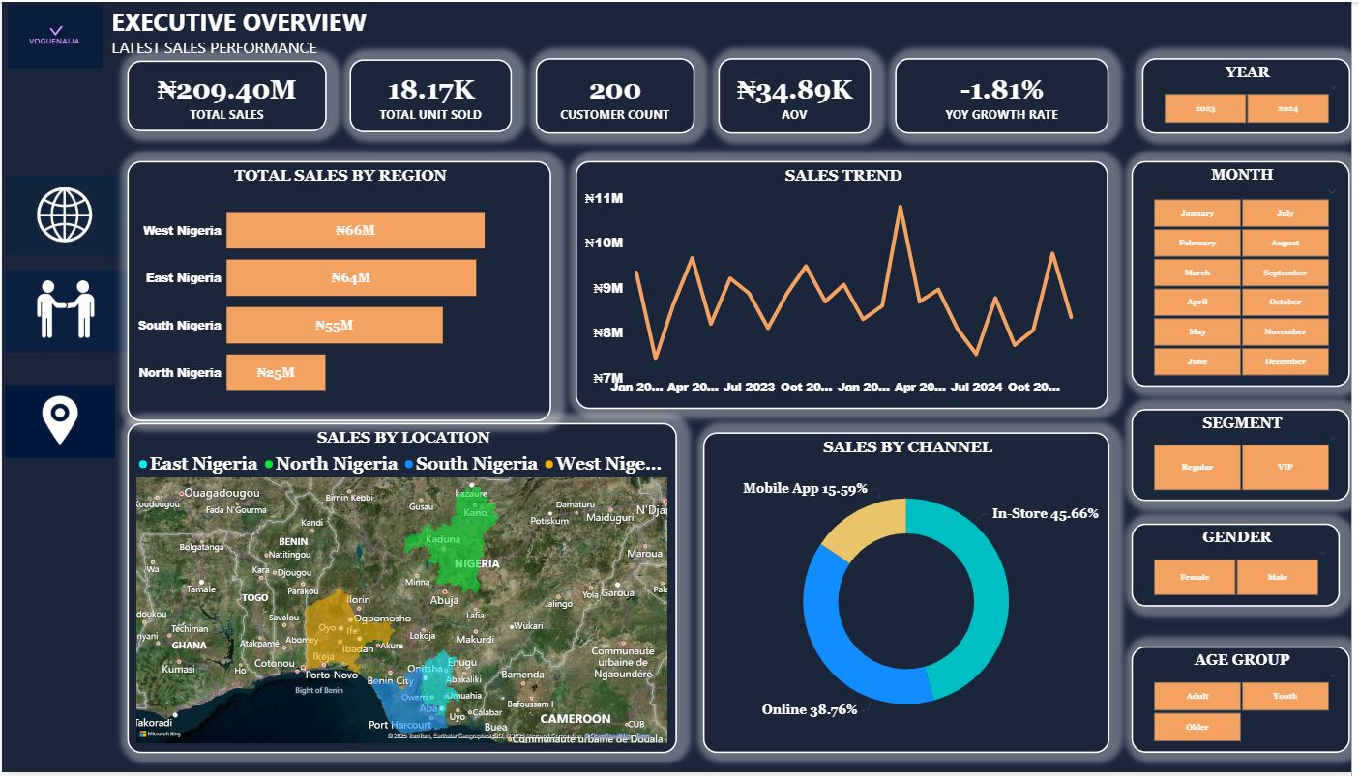
Snapshot of the VogueNaija DashBoard Executive Overview
Notes:
--- This slide references information from the following file: https://ulster-my.sharepoint.com/personal/adebayo-ad_ulster_ac_uk/Documents/Microsoft%20Copilot%20Chat%20Files/NaijaStream%20PDF%20EXCEL.pdf The visualization component of the analysis is designed to address several key business questions. These include quantifying total revenue, total orders, MRR, ARR, ARPU, and churn rate. The dashboard also visualizes device usage distribution and regional revenue breakdowns. It provides insights into average revenue per subscription tier and compares churn versus retention across tiers. Additionally, the dashboard identifies top revenue-generating states and tracks growth trends over time. These visualizations serve as a strategic tool for monitoring performance and guiding business decisions.

Slide 8
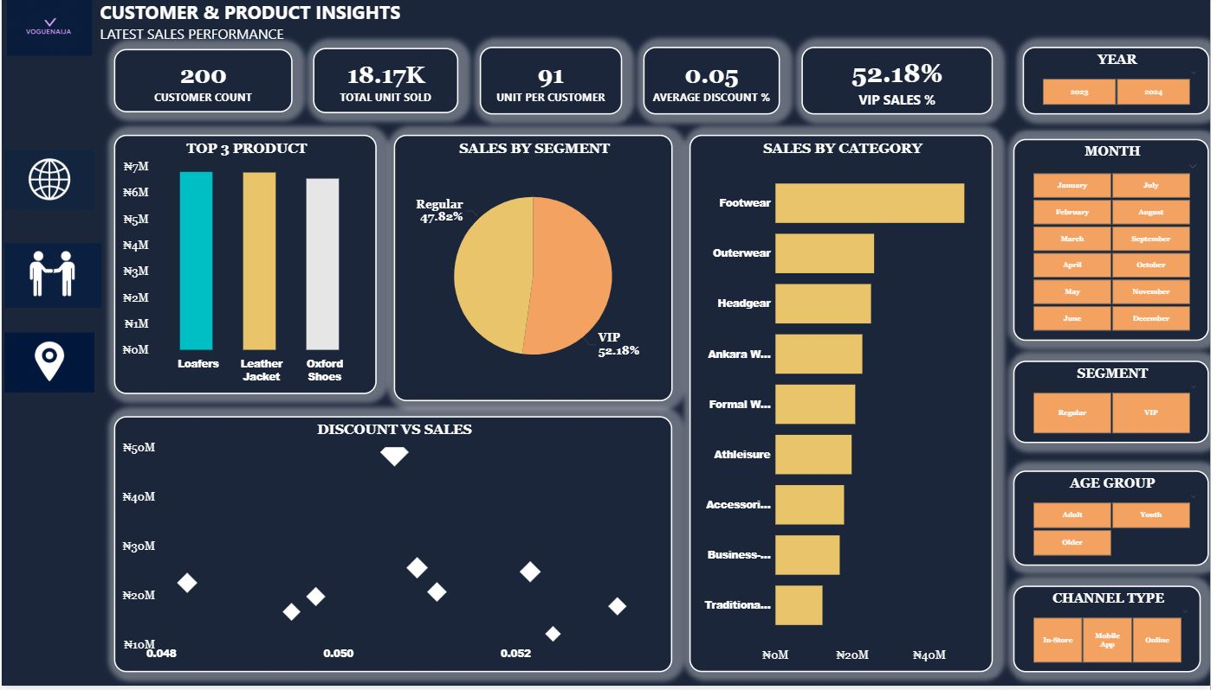
Snapshot of the VogueNaija DashBoard Customer & Product Insight
Notes:
--- This slide references information from the following file: https://ulster-my.sharepoint.com/personal/adebayo-ad_ulster_ac_uk/Documents/Microsoft%20Copilot%20Chat%20Files/NaijaStream%20PDF%20EXCEL.pdf The visualization component of the analysis is designed to address several key business questions. These include quantifying total revenue, total orders, MRR, ARR, ARPU, and churn rate. The dashboard also visualizes device usage distribution and regional revenue breakdowns. It provides insights into average revenue per subscription tier and compares churn versus retention across tiers. Additionally, the dashboard identifies top revenue-generating states and tracks growth trends over time. These visualizations serve as a strategic tool for monitoring performance and guiding business decisions.

Slide 9
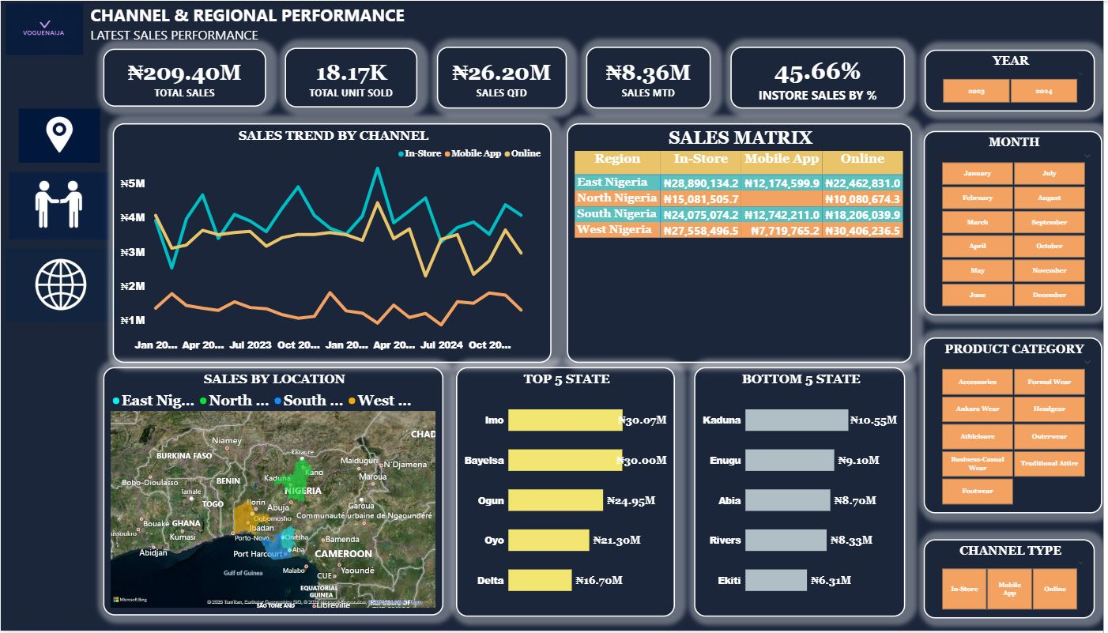
Snapshot of the VogueNaija DashBoard Channel & Regional Performance
Notes:
--- This slide references information from the following file: https://ulster-my.sharepoint.com/personal/adebayo-ad_ulster_ac_uk/Documents/Microsoft%20Copilot%20Chat%20Files/NaijaStream%20PDF%20EXCEL.pdf The visualization component of the analysis is designed to address several key business questions. These include quantifying total revenue, total orders, MRR, ARR, ARPU, and churn rate. The dashboard also visualizes device usage distribution and regional revenue breakdowns. It provides insights into average revenue per subscription tier and compares churn versus retention across tiers. Additionally, the dashboard identifies top revenue-generating states and tracks growth trends over time. These visualizations serve as a strategic tool for monitoring performance and guiding business decisions.

Slide 10

Critical Analysis and Insights
Regional leader: West Nigeria (₦65,684,498)
Top channel: In-Store (~45.7% share)
Segment mix: VIP leads (~52.2%), but both segments are material
YoY growth: -1.81% — momentum requires attention
Notes:
--- This slide references information from the following file: https://ulster-my.sharepoint.com/personal/adebayo-ad_ulster_ac_uk/Documents/Microsoft%20Copilot%20Chat%20Files/NaijaStream%20PDF%20EXCEL.pdf,https://ulster-my.sharepoint.com/personal/adebayo-ad_ulster_ac_uk/_layouts/15/Doc.aspx?sourcedoc=%7BE3F7B0B7-554E-4598-8291-D631F943A80D%7D&file=NAIJA%20STREAM%20EXCEL%20FILE%20(DASHBOARD,%20KPI,%20CLEAN%20DATA%20AND%20RAW%20DATA).xlsx&action=default&mobileredirect=true The analysis reveals several critical insights into NaijaStream’s operations. West Nigeria emerges as the highest revenue-generating region, contributing ₦1.59 million or 27% of total recurring revenue. Premium tier users have an ARPU that is 46% above the overall average, while Basic tier users fall 48% below, indicating a strong upsell opportunity. Enugu, Lagos, and Kano states collectively generate ₦2.6 million, accounting for 21% of total revenue. Device usage analysis shows Mobile as the dominant platform with 47.8% of active users, followed by Desktop at 32.68% and Smart TV at 19.55%. The churn rate is notably high at 49.35%, particularly among monthly plan users. Growth trends in MRR and ARR exhibit fluctuations, suggesting the need for more consistent engagement strategies. These insights provide a foundation for targeted interventions and strategic planning.

Slide 11
Recommendations for Improvement
Prioritize leading regions/states with geo-targeted campaigns
Improve App adoption via exclusive drops, UX, and gamification
Expand VIP loyalty; upgrade Regulars via tiered perks
Align inventory to top categories; time promos to seasonal peaks
Notes:
--- This slide references information from the following file: https://ulster-my.sharepoint.com/personal/adebayo-ad_ulster_ac_uk/Documents/Microsoft%20Copilot%20Chat%20Files/NaijaStream%20PDF%20EXCEL.pdf Based on the analysis, several strategic recommendations are proposed to enhance NaijaStream’s performance. First, localize marketing and content strategies in top-performing regions such as West, North, and East Nigeria to capitalize on their combined revenue potential. Second, enhance the value proposition of annual plans for Premium subscribers by offering loyalty perks like bonus months or early access to content. Third, implement targeted upsell campaigns for Basic tier users to encourage upgrades and boost ARPU. Fourth, prioritize UI/UX improvements on mobile platforms, which account for nearly half of active users, to increase engagement and retention. Lastly, deploy churn-reduction campaigns for monthly plan users, including in-app win-back messages and email reminders. These recommendations aim to reduce churn, increase revenue, and improve overall user satisfaction.

